Slide 1
LINQ Connect www.linqconnect.com
Applying for Free & Reduced Meals

Slide 2
2023-2024 KCS Cafeteria Meal Prices
Breakfast $2.00 All Grades
Lunch $2.75 (PK-5)
$3.00 (6-12)
Reduced-priced meals:
Breakfast $0.30
Lunch $0.40
If you submit a meal application and are approved for free meals,
your child will not be charged for breakfast or lunch.

Slide 3
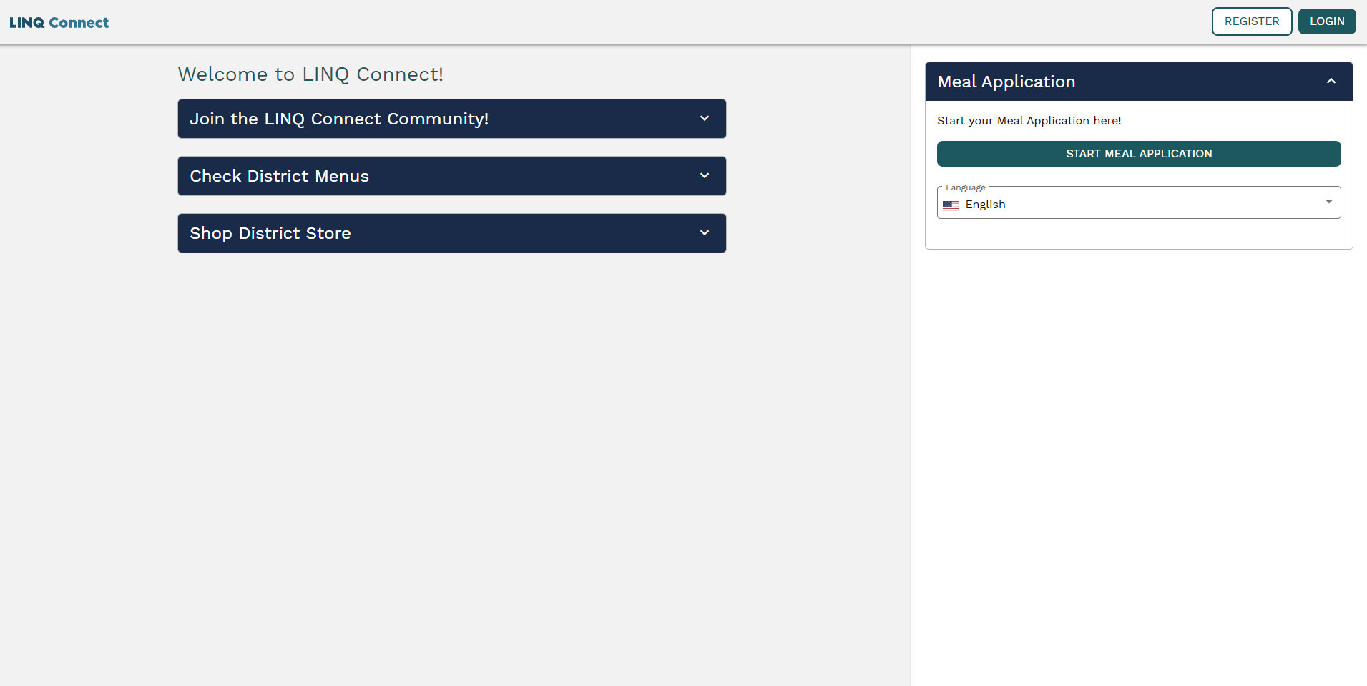
Click here to start an online meal application.
Click on the drop-down box to choose preferred language.
This PowerPoint will walk you through submitting an online free and reduced meal application without registering or logging in to a LINQ Connect account.
*NOTE* We recommend you watch the PowerPoint on “How to Register for a LINQ Connect Account”.

Slide 4
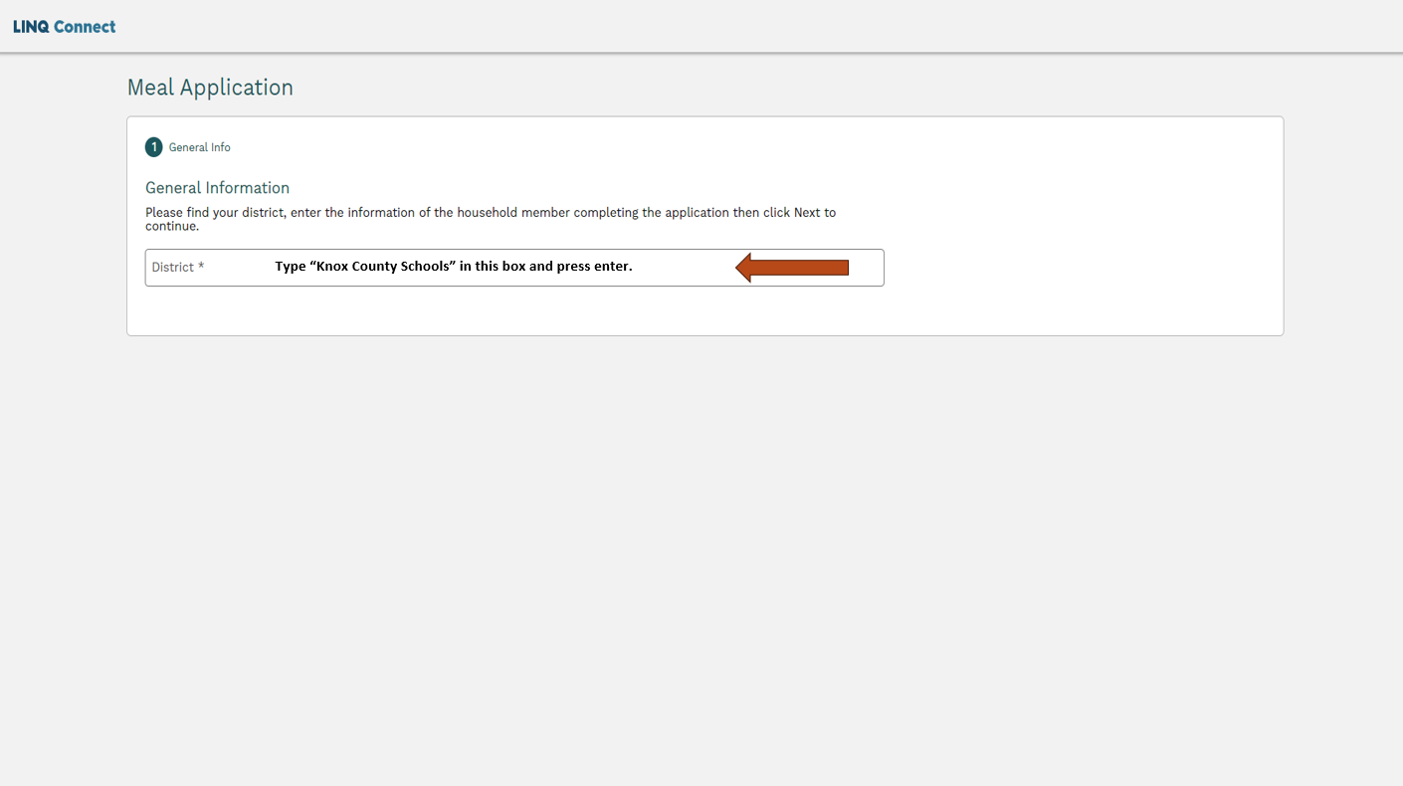

Slide 5
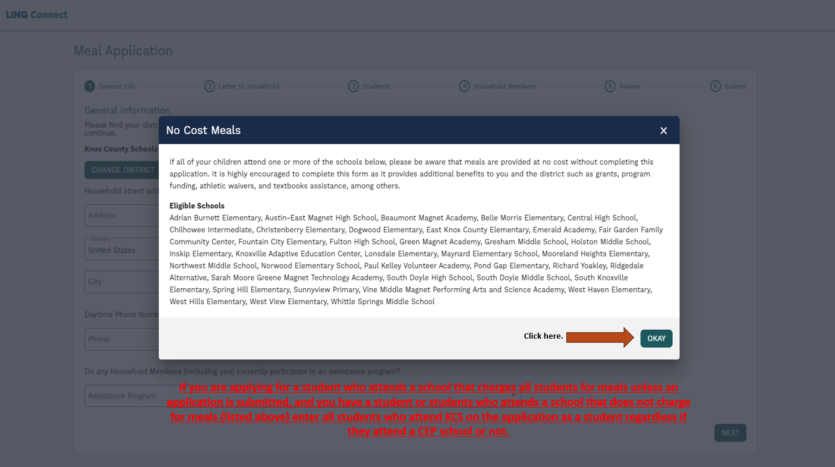

Slide 6
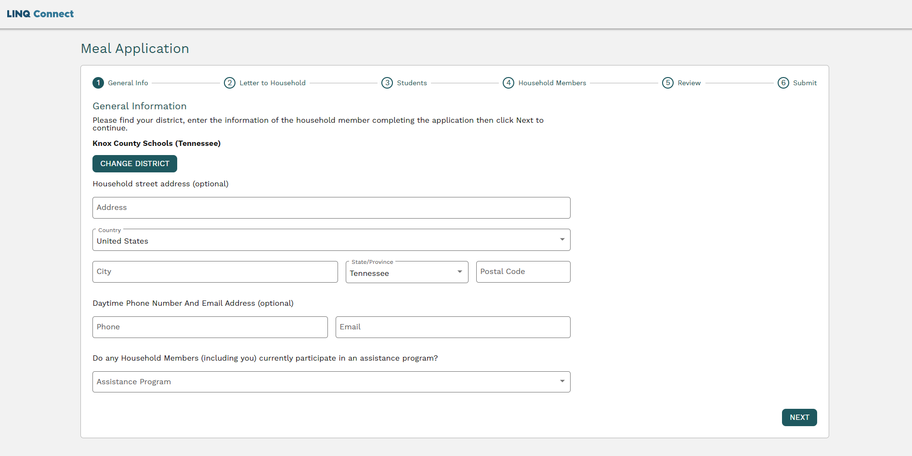
Use the e-mail address you provided when you signed up for your LINQ Connect account.
Click the drop-down box if someone who lives in your home participates in SNAP or TANF.
If you choose one of the listed programs, you will need the case number DHS provided to you when you were approved for the benefit. NOTE: Your case number is NOT your SNAP benefits card number. If you do not know your case number call DHS at 866-311-4287 to obtain the correct number before going to the next step.
Click “Next” when complete.

Slide 7
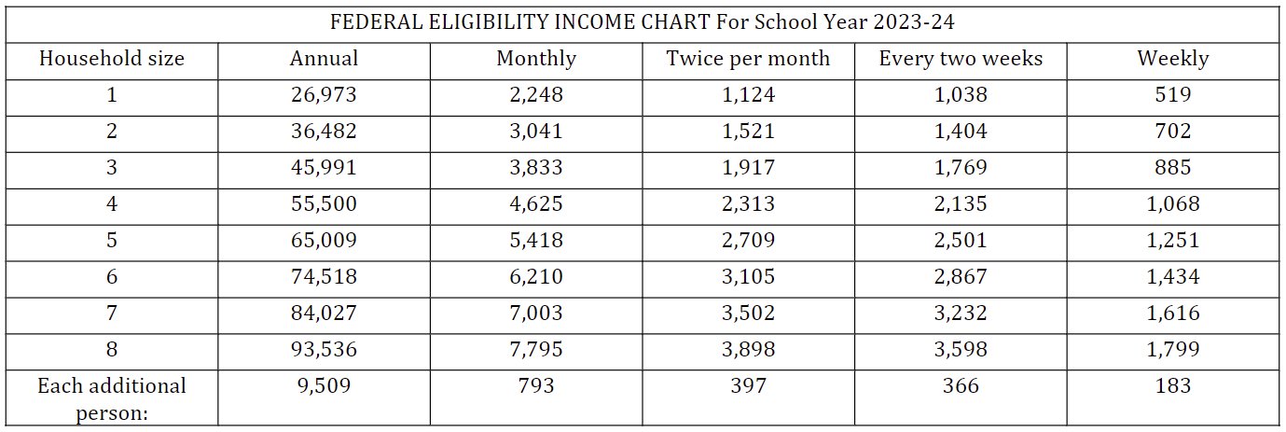
If your household income falls at or below the limits on this chart, your children may be eligible for free or reduced-priced meals.

Slide 8
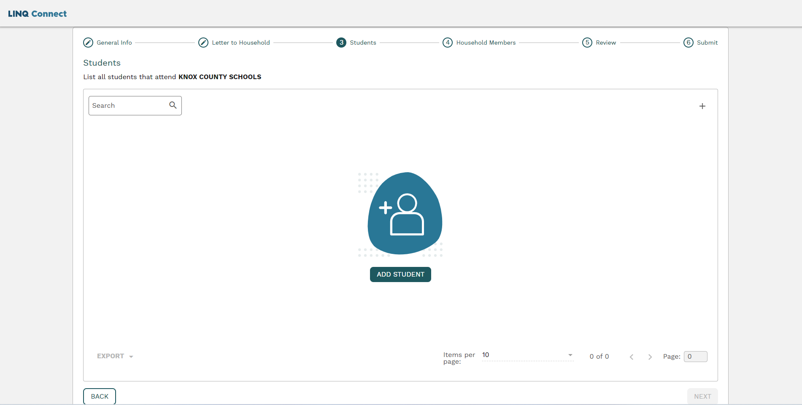
Click here to begin adding students who live in your home and are currently attending Knox County Schools.
To complete and proceed you will need your child’s student ID number. If you are unaware of the ID number, please contact Mona Underwood at 865-594-9563 or email mona.underwood@knoxschools.org.
To proceed, please click “Next”.

Slide 9
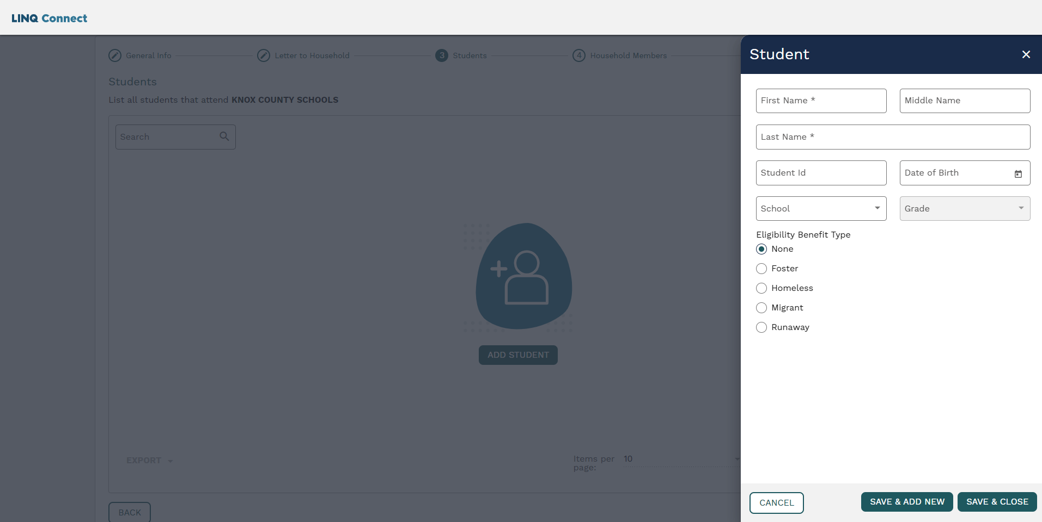
Click on the drop-down box to select the school your child attends.
Click on the drop-down box to select the grade your child is in.
To include more students who attend KCS, save this page and add their information by clicking here.
If you do not have any more students who attend KCS, click here.

Slide 10
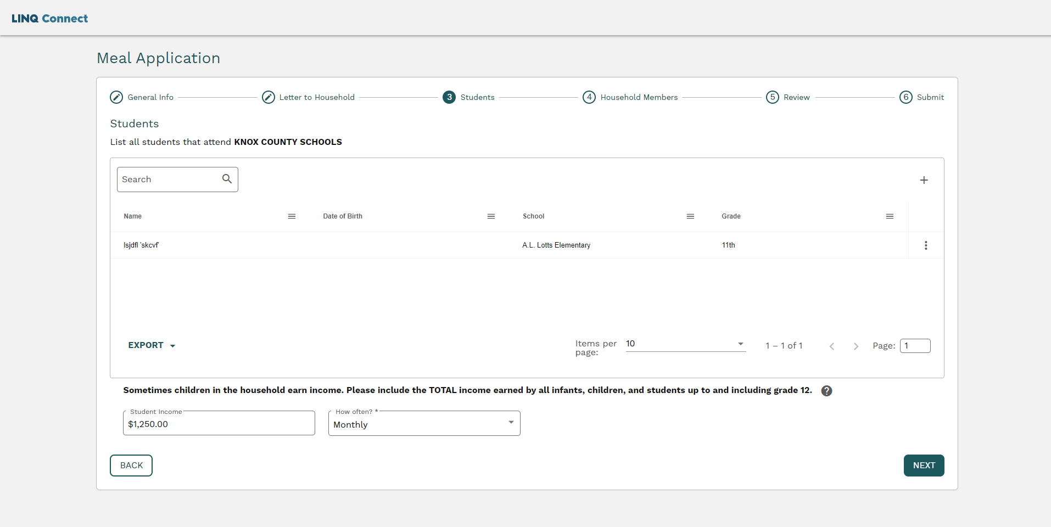
This page should include all students entered on this application who attend KCS along with all income you entered students if any.
If any of the students receive income enter the amount here.
Choose from the drop-down menu to select the frequency of payment if the student receives income.
To proceed, please click on the “Next” button.

Slide 11
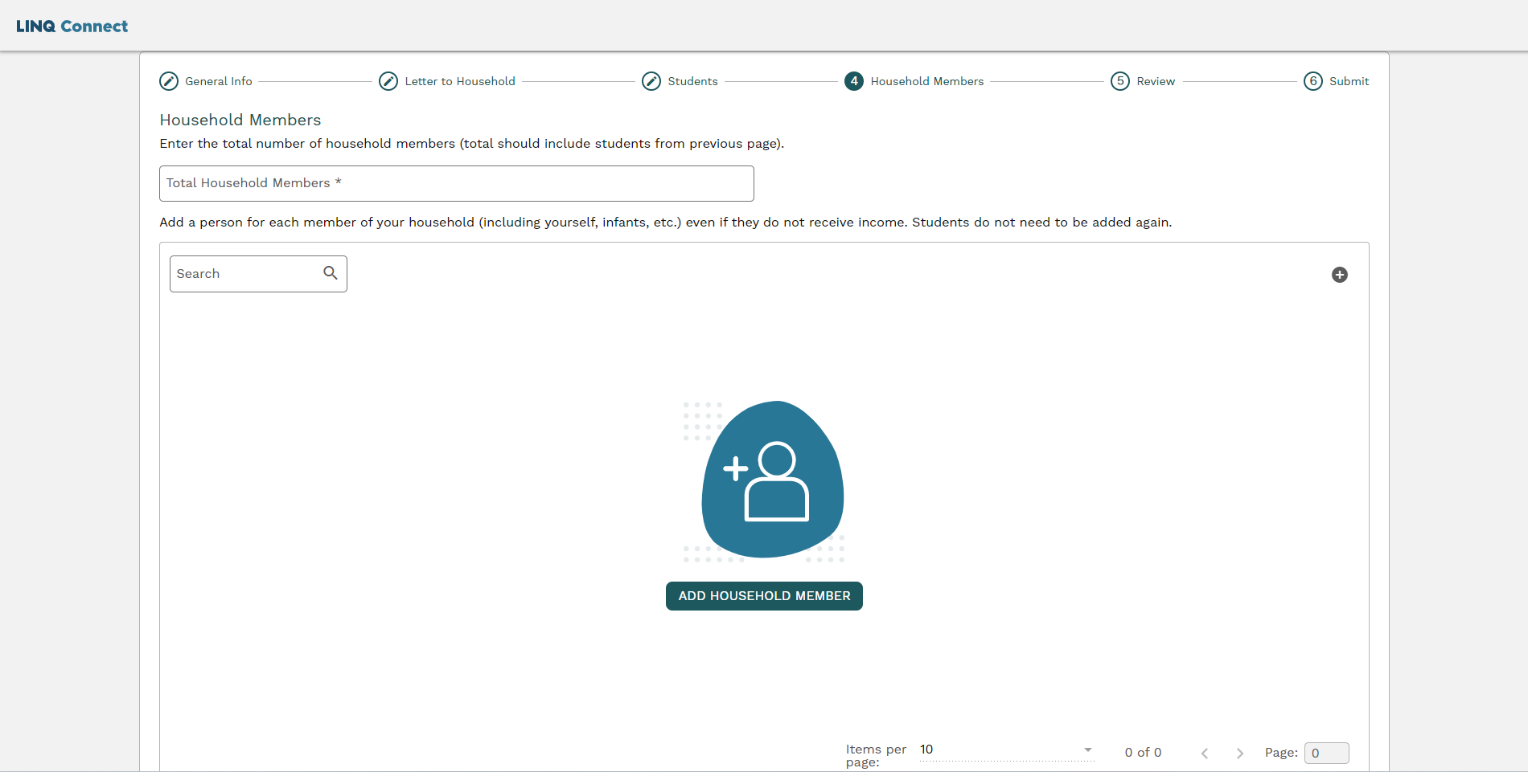
Enter the total number of household members you have added to this application. This includes you, all students who attend KCS, all children living in the house who do not attend KCS, and all adult members living in your home. This number must match exactly the number of people on this application.
Click the “+” sign to begin entering all household members including yourself, all children who live in your home and do not attend KCS, and all adult members living in your home.

Slide 12
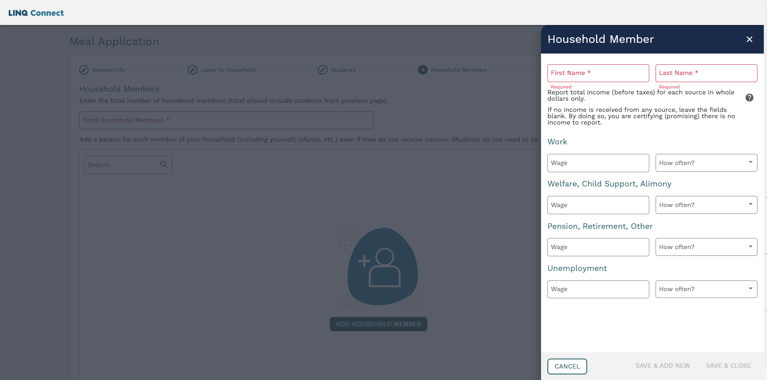
Enter gross wages amount here. Gross wages are the amount you are paid from work before anything is deducted from your check.
If you have income from any of the listed sources use the drop-down boxes to enter the frequency of pay.
If you receive child support or alimony, enter only what you receive even if the court has ordered a different amount to be paid.
If you receive a pension, retirement, or social security, enter the amount here.
Click here
If you receive unemployment enter the amount here.
If you have more people who live in your home, click here to save this information and add additional household members.
Click here if there are no more household members to add to this application.

Slide 13
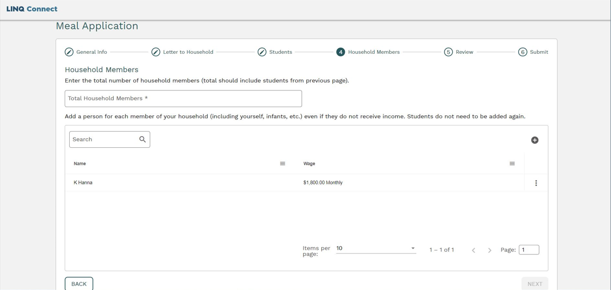
Enter the total number of household members you have added to this application. This includes you, all students who attend KCS, and all adult members, living in your home. This number must match exactly the number of people on this application.
Click here if you need to go back to the previous page.
Click here to continue.

Slide 14
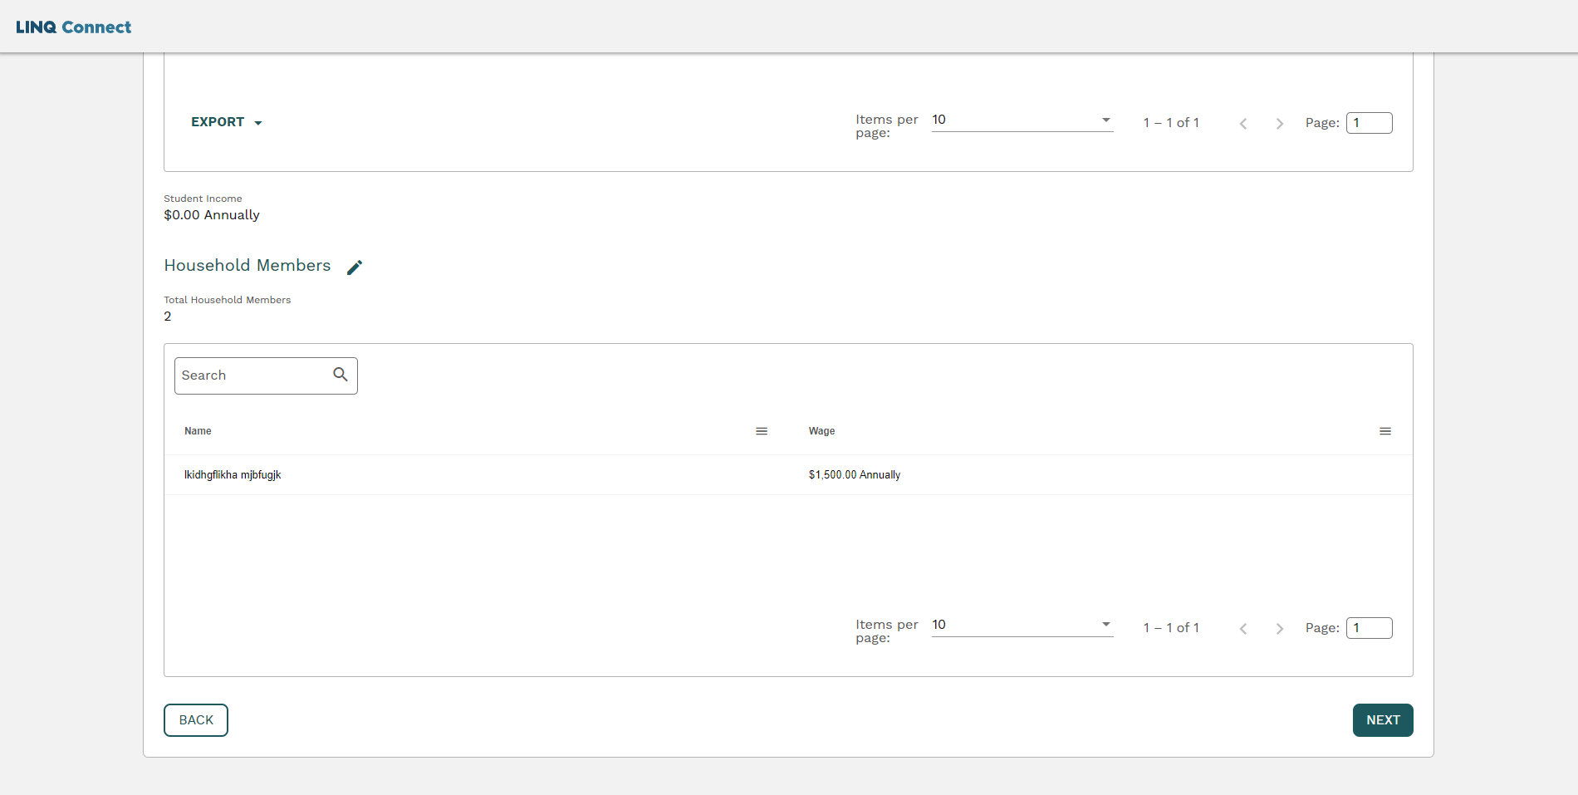
This page should show all members who live in your home, (excluding students attending KCS) along with any income entered.
Click “Next” to continue.

Slide 15
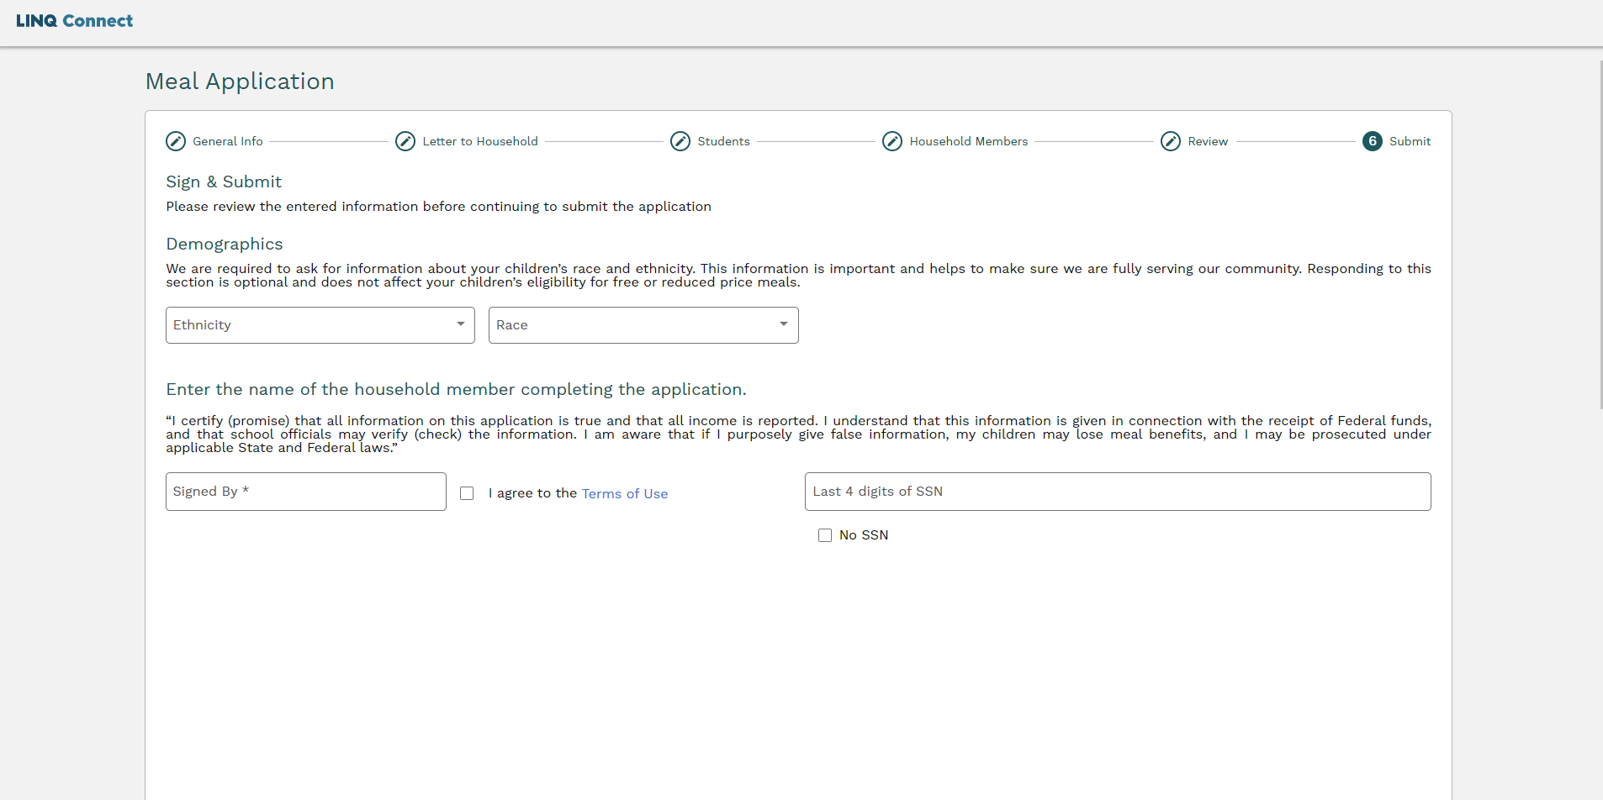
These two questions are optional. If you choose to answer these questions, click on the drop-down box.
The name you enter here must be spelled the exact way you have entered it on the application.
Click the box if you agree to the Terms of Use.
You must enter the last four numbers of your Social Security number or click on the box that says “No” if you do not have one.

Slide 17
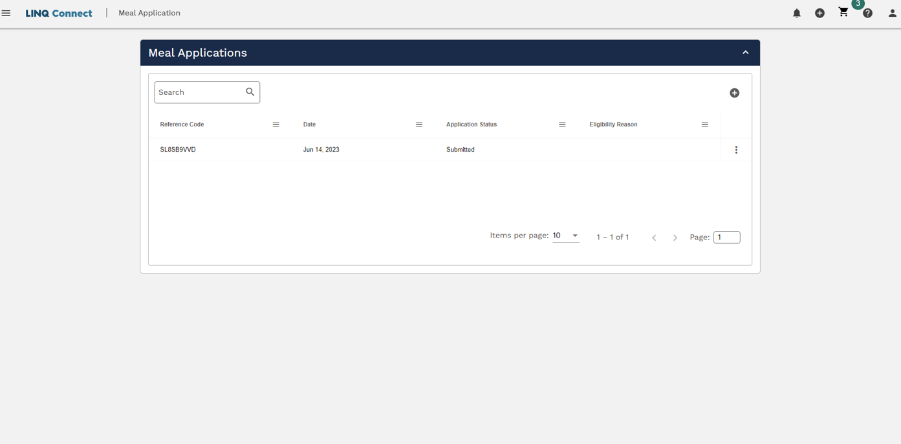
Please make sure the Application Status says “Submitted” before exiting the application process.

